Slide 1

extreme Programming
Deepak Vishwakarma

Slide 2
Extreme Programming as Agile Methodology
The Manifesto for Agile Software Development
“We are uncovering better ways of developing software by doing it and helping others do it. through this work we have come to value:
Individuals and Interactions over Processes and Tools
Working Software over Comprehensive Documentation
Customer Collaboration over contract negotiation
Responding to change over following a plan
That is, while there is value in the items on the right, we value the items on the left more.” -Kent Beck

Slide 3

Extreme Programming(XP)
Xp was developed by “Kent Beck” and introduced in his first book
“Extreme programming explained: embrace change (addison-wesley, 1999)”.
It was one of the earliest agile methodologies and the first one that challenge the traditional waterfall model.
Xp is a designed to support a small/medium software development teams.
It’s called “extreme programming” because it takes 12 known proven software development principles/practices and push them to extreme levels.

Slide 4

VALUES OF EXTREME PROGRAMMING - SIMPLICITY
The team members will focus on things that matters and don’t waste time on things that they doesn't ask for.
Do the simplest that could possibly work.
Remove any code that you will not use.
"XP is making a bet. It is betting that it is better
to do a simple thing today and pay a little
more tomorrow to change it if it needs it, than to do a more complicated things today that may never be used anyway.“
- Kent Beck

Slide 5

COMMUNICATION
There should be a good communication between the team and the client.
The entire team members should work together to complete each task.
Face to face communication will reduce the need of documentation.
The project coach should validate that there is a good communication (Developers->developers, developers->client etc.)

Slide 6

COURAGE
Developers should have the courage to take fast decisions due to the collective ownership.
Developers should have the courage to make real changes in the software design and architecture when needed.
Developers should have the courage to tell the truth about the effort they need to complete tasks (time estimations, implementation effort etc.)

Slide 7
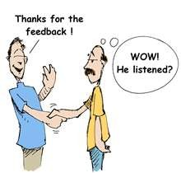
FEEDBACK
Extreme programming embraces feedback as a great way to evaluate the current state of the development process.
Fast feedback will increase the effectiveness of the process.
Each resource that involved in the project
Is relevant, examples:
Developers – estimate the user stories and respond with estimations.
Customer – test the software and send feedbacks
That will increase the quality.

Slide 8

RESPECT
Respect the other team members.
Respect the customer.
Respect the project.

Slide 9
ACTIVITIES IN EXTREME PROGRAMMING

Slide 10

CODING
All developers should follow a predefined code standards.
Continuous integration throughout the entire process.
The code is based on the customer user stories.
The customer should be available at all time.
First code is written for unit tests.
Collective code ownership.
Pair programming.

Slide 11

TESTING
Every part of the code should be tested with a dedicated unit test.
You cannot say that your code is working until you test it.
All tests should run on every new build.
Testing is made by the developers(unit) and by the customer (atp for functionality).

Slide 12

LISTENING
Developers should listen to the client requirements about how the
System should develop.
Developers should listen to each other to develop a better and resilience software.
Developers should listen to the client feedback about the generated code.

Slide 13
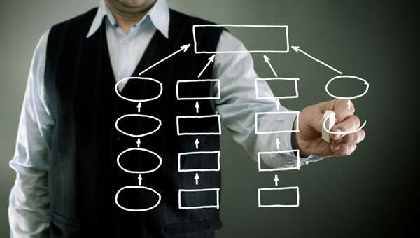
DESIGNING
A good and simple design will reduce the complexity of the system.
Every developer can take an active part in the design process.
The design is made at the start and during the process.
Refactoring is a decisive part of the design process.
Although xp embraces fast development that add business value, it doesn't mean that the designing process is excluded.

Slide 14
EXTREME PROGRAMMING CORE PRACTICES

Slide 15
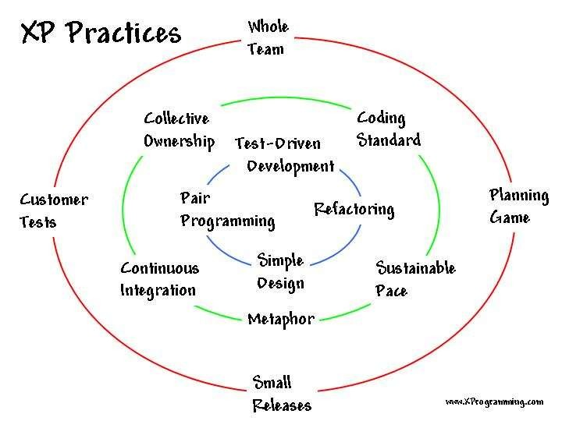
12 Key practices
The planning game
Small releases
System metaphor
Simple design
Continuous testing
Refactoring
Pair programming
Continuous integration
Collective ownership
On-site customer
The 40-hour week
Coding standards

Slide 16
PLANNING GAME
The company evaluates the client requests against the cost estimations and development time.
The primary goal is to produce the maximum business value in the fastest way.
There are three basic rules to follow on this phase:
Business produces the list of requirements from the client (user stories).
Engineering team review the “user stories", and then answer these two questions:
What is the time estimation and effort will they need to put in order to deliver each user story…?
How much effort the team can produce per iteration (how many user stories They can deliver per iteration)…?
Business review the estimations and decide what are the user stories that will be developed and in what order.

Slide 17

SMALL RELEASES
The main target is to release a working and tested software early as possible.
The first release is developed with the smallest useful set of features to increase the business value.
Software updates should be developed often to support fast releases.
The customer can use this software in its own environment that involve real users(which allowing the customer to evaluate the software and send his feedbacks).

Slide 18

SYSTEM METHAPHOR
Metaphor in xp is the common vision of the team members on how the program should develop and work.
Each project as it’s “metaphor”, is job is to guide the project resources
On how the whole system works (components, integrations etc).
Another responsibility of the “metaphor”, is to determine a set of keywords that describes a common technical entities (common terms, class names etc.).

Slide 19
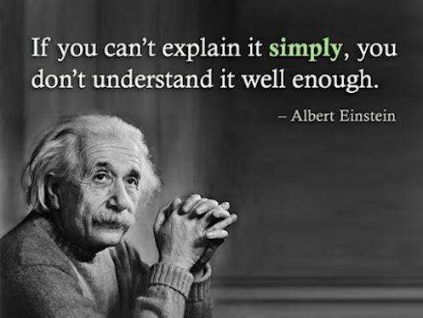
SIMPLE DESIGN
In agile methodology the requirements are frequently changed, based on this assumption, you should always use the
Most simplified software designs that allowing you to make the job done.

Slide 20

CONTINOUS TESTING
Testing is done throughout the entire process.
All tests must run and pass with 100% before a new development.
There are two type of tests that involve in this process:
Test driven development (tdd)
Programs write the tests prior to the application code development.
The code is produced with almost 100% test coverage.
Automated tests that are written by the development team(per functionality)
Acceptance tests
This tests is the “contract” between the customer and the company
The client can validate that the software is developed as specified.
Tests that are specified by the customer.

Slide 21

REFACTORING
To achieve value per iteration, the development team must build the software based on simple and effective design.
Refactoring is a continues design improvement that developers can do at any time.
Refactoring cannot be made without a corresponding testing to ensure that nothing was broken.
During the refactoring phase, programmers can:
Edit their code (edit code but, without changing the functionality).
Improve the software design.
Remove any code duplication.

Slide 22

PAIR PROGRAMMING
Two programmers are working on the same computer to complete a single task.
Programmer no’1 – responsible to write and implement the code.
Programmer no’2 – watch the implementation and identifies any code errors.
The assumptions
Programmers will gain more confidence in their code.
Developers will enjoy working together.
Tasks will be resolved faster.
Produce higher quality code

Slide 23

CONTINOUS INTEGRATION
In xp developers must keep the system fully integrated at all times
All unit tests must be run and pass with 100%.
New builds are created daily with the full code(the entire code that was developed by this point).
Any development is integrated to a single location when the code is ready.

Slide 24

COLLECTIVE CODE OWNERSHIP
Any developer must have the ability to work on any part of the code.
No specific developer that responsible for a specific component.
Code can be changed by any developer without delay.
A new code is reviewed by the entire team.
Increase the responsibility of developers.

Slide 25

ONSITE CUSTOMER
The customer should lead the project (requirements, priorities and timelines).
The customer should be available at all time (face to face communication).
Developers will not use any assumptions during the development process.
The customer is one of the most important resources in xp process.
The customer should answer any open questions.
Developers can access to a real client environment(where the software is implemented.).

Slide 26

40 HOUR WEEK
The team will go home on time, there is no reason to do overtime hours.
The project shouldn’t interfere with the developer’s personal life.
The work week should be no more than 40 hours.
Tired developers do more coding mistakes.
In most projects, this practice is not relevant, the real world is different from the theoretical one ☺
Consecutive overtime hours will indicate that there is something wrong in the process.

Slide 27

CODING STANDARDS
Coding standards will help to develop a better code.
Every developer should follow the code standards.
Code review should be used as a method to validate that the expected standard is enforced
Examples for “code standards”:
The code must include comments per method.
Coding conventions (formatting, naming, log).
Develop based on a specific design pattern.
The code should be easy to maintain.

Slide 28
EXTREME PROGRAMMING PARTICIPATING ROLES

Slide 29


XP ROLES
Customer
Responsible to specify and test the software functionality.
Specify the software requirements and specifications.
Determines the development priorities.
Create and explains the user stories.
Coach
Monitor the entire process and validate that the project stays on course.
Guides and mentors the team members.
Should lead by example.

Slide 30

XP ROLES
Developer
Maintain the software through the process and after implementation.
Make the code implementation( user stories into working code).
Estimates the time and effort of the user stories.
Test the code (automated unit tests).
Doomsayer
Responsible to make sure that when a crises occurs; everyone will know about it.
Validate that each resources knows the risk involved.
Responsible to make sure that small issues remain small and not get out of proportion

Slide 31


XP ROLES
Tracker
Validate that each developer is on track with his assigned tasks.
Validate that each developer is synchronized at all time.
Arrange meetings with the client when necessary.
Validate that the project is going as scheduled.
Tester
Report for defects and any other issues that may affect the user experience.
Test the software functionality.

Slide 32
Reference and bibliography
Beck, K. (1999). Extreme Programming Explained: Embrace Change. Addison-Wesley. ISBN 978-0-321-27865-4.
M. Mizanur Rahman, CSD 2018.
"Extreme Programming Rules". extremeprogramming.org.
Kent Beck and Martin Fowler: Planning Extreme Programming, Addison–Wesley.

